Slide 1
The Flemish Aerospace Group (FLAG) and success stories of research and development in the Flemish aviation sector.
Helge Pfeiffer
KU Leuven (University of Leuven) - LASA
FLAG – Technology Working group
Kris Van der Plas
FLAG – Managing Director

Slide 2
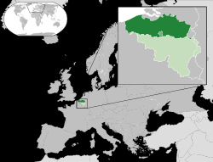
Geography
Dutch speaking part of Belgium
Capital = Brussels

Slide 3
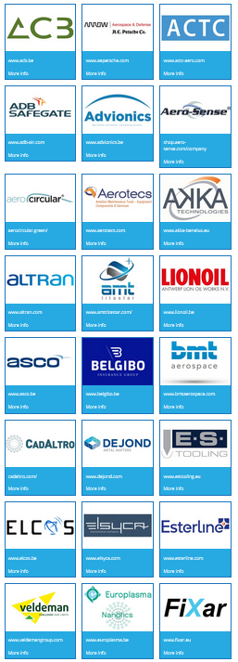
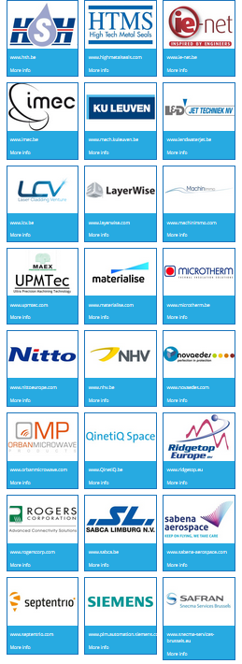
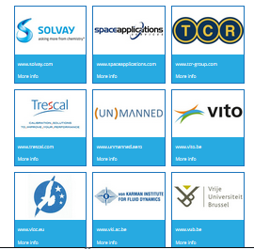
FLAG
Flemish Aerospace Group

Slide 4
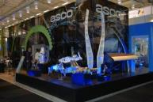
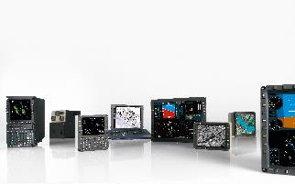
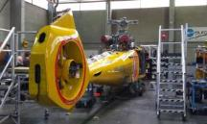
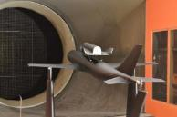
Key numbers of our members
Annual turnover > 1,1 billion € (2014)
> 3200 employees (2014)
60 member companies (33 in June 2014)
  7 universities and research institutes
  Products, materials, services
  Airport industry

Slide 5
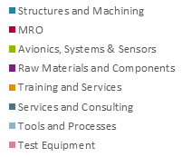
Industry in detail
Turnover Employment

Slide 6
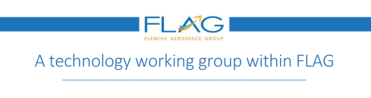
Since December 2016 – Working group for Research & Development within FLAG – Facilitator for future collaborations

Slide 7
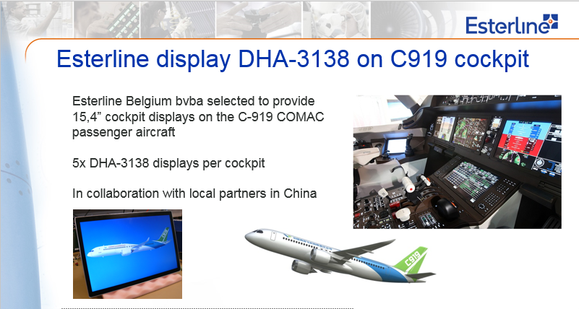
Existing cooperation – Esterline

Slide 8
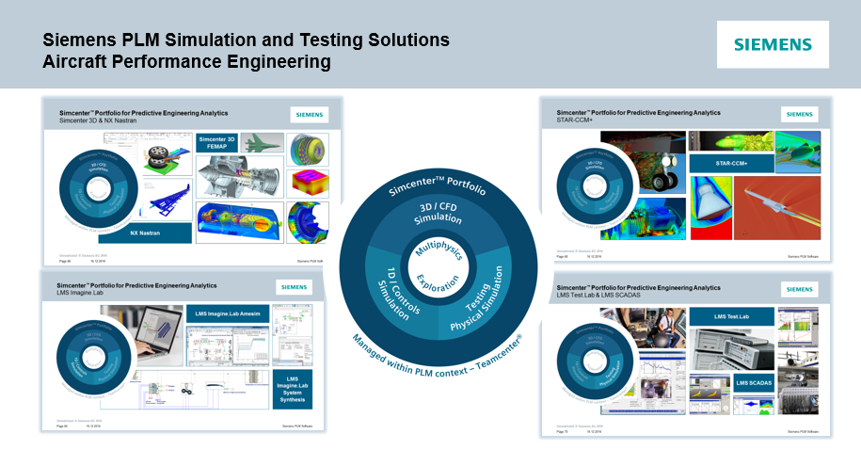
Existing cooperation – Siemens

Slide 9
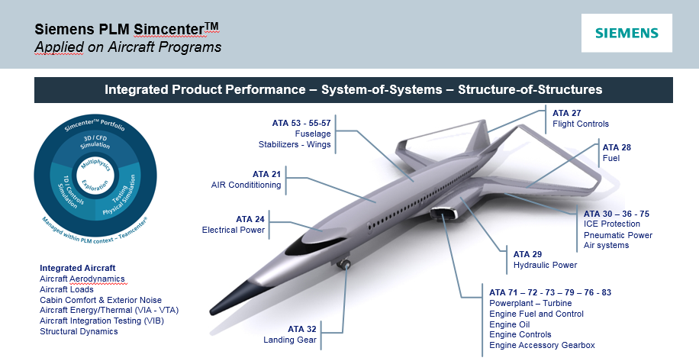
Existing cooperation – Siemens

Slide 10
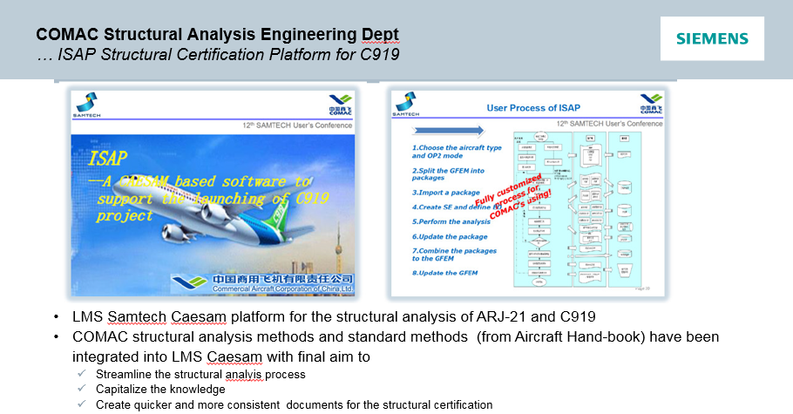
Existing cooperation – Siemens

Slide 11
Academic aviation research
From research to products

Slide 12

Examples from the
University of Leuven (KU Leuven)
Leuven Centre for Aero & Space
Science, Technology and Applications

Slide 13
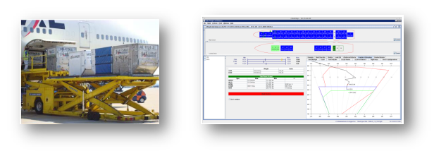
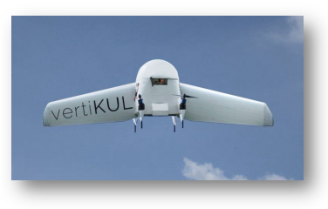
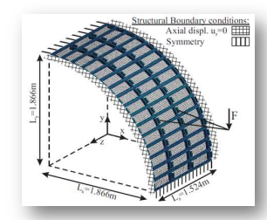
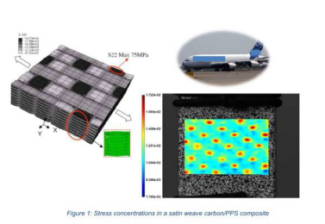
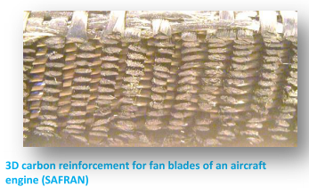
Unmanned Aerial Vehicles (UAV’s) for fast
and autonomous delivery or surveillance
Air cargo selection and weight balancing
for fuel saving
Optimisation of the reinforcement structure of 3D reinforced composite fan blades
Digital image correlation for stress/strain
analysis and damage detection
Acoustic and Vibration
research for Aeronautics

Slide 14
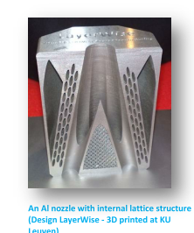
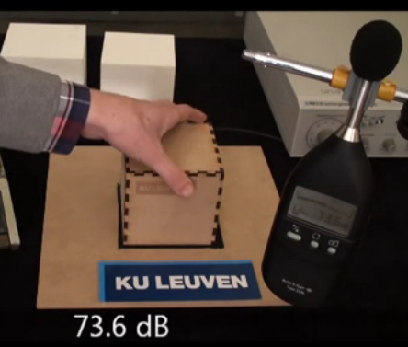

Additive manufacturing
Master Course on Aeronautics and Astronautics
Metamaterials for highly advanced sound isolations

Slide 15
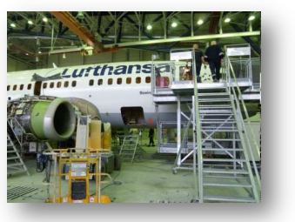

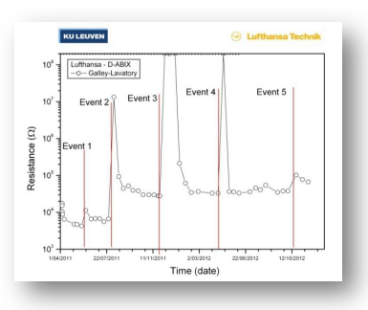
Water leakage monitoring in aircraft by permanent sensor networks
… in airborne operations since 2011

Slide 16
http://flag.be/site/wp-content/uploads/2015/11/AVIATION-SCIENCE-AT-THE-KU-LEUVEN.pdf

Slide 17


Contacts
Kris Van der Plas
kris.vanderplas@flag.be
FLAG
Managing Director
Auguste Reyerslaan 80
B - 1030 Brussel | Belgium
Mobile: +32 (0)497 47 74 95
Helge Pfeiffer
helge.pfeiffer@kuleuven.be
KU Leuven (University of Leuven) - LASA
Industrial research manager and senior researcher
Kasteelpark Arenberg 44 bus 2450
B – 3001 Leuven | Belgium
Tel: +32 (16) 32 12 32

